Slide 1


Slide 2

VIT
Topic/Course
Sub-Topic (Example: name of college)

Slide 3

Circular Permutations

Slide 4

Circular Permutations
Circular Permutations:
When ‘n’ items are arranged in a circle, the number of arrangements of these ‘n’ items compared to arranging them in a straight line will be lesser. This happens because, in a straight line, we can have two different arrangements namely ABCD and DABC, whereas in a circle these two arrangements will be considered the same. To calculate the number of permutations of ‘n’ items arranged in a circle , one element can be fixed and all the various arrangement around it can be calculated.
For example, to calculate the number of ways in which five women (Rose, Jean, Marie, Lily and Amy) can sit around a table, we can first arrange them in a straight line. There are 5! Ways to arrange them.

Slide 5
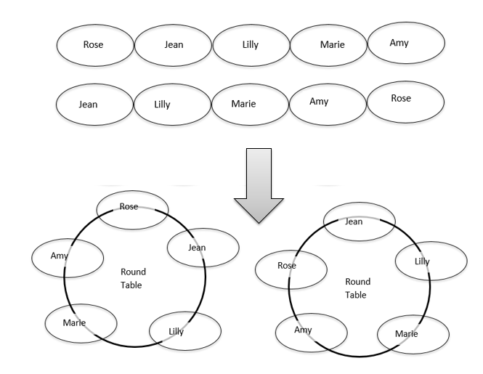
Circular Permutations

Slide 6
Circular Permutations
Thought the arrangements Rose-Jean-Lilly-Marie-Amy and Jean-Lilly-Marie-Amy-Rose are different, when arranged in a circular manner, they are same.
If one of them, say Lilly, is fixed, the number of ways in which the other women can sit around her is equal to 4!.
The number of ways in which ‘n’ distinct items can be arranged in a circle will be (n-1)!.
In certain cases, for example, jewels in a necklace or garlands, there is no difference between clockwise and anticlockwise arrangements. In those cases, the total possible arrangements are half of the original ways of arrangements, that is [(n-1)!]/2.

Slide 7
Question 1
In how many ways can 5 boys and 3 girls sit around a table, if no two boys should sit together?
A)
3!*4!
B)
3!*5!
C)
8!
D)
None of these.
Notes:
Answer: D
Such a situation is not possible because on any arrangement among 8 people, 2 boys will always come together.
So, the answer is none of these.

Slide 8
Question 2
In how many ways can six boys and six girls sit around a round table, if no two girls should sit together?
A)
68000
B)
72000
C)
86400
D)
86000
Notes:
Answer: C
Totally, 12 persons are sitting around a round table. Since it is a round table, we can fix a person in one of the chair. Let us fix a boy in a chair and the other five boys are made to sit in the alternate chairs. Thus, to arrange five boys in five alternate chairs, there are 5! = 120 ways. In the remaining six chairs, six girls are made to sit in 6! = 720 ways. Hence, total ways = 5! × 6! = 86400 ways.

Slide 9
Question 3
How many necklaces can be formed with 8 different coloured beads?
A)
7!/2
B)
8! x 2
C)
8!/4
D)
7!
Notes:
Answer: A
Whenever u get keyword as a necklace the no of ways in which I could be rearranged = (n - 1)! / 2Therefore no of ways = (8 - 1)! / 2
= 7!/2

Slide 10
Question 4
In how many ways can 19 people be seated around two round tables with seating capacities of 10 and 9 people?
A)
¹⁹C₁₀ × 8! × 9!
B)
18!/9!
C)
9! × 8!
D)
19C10 × 10! × 9!
Notes:
Answer: A
Total ways = 19 C₁₀ × 9! × 8!

Slide 11
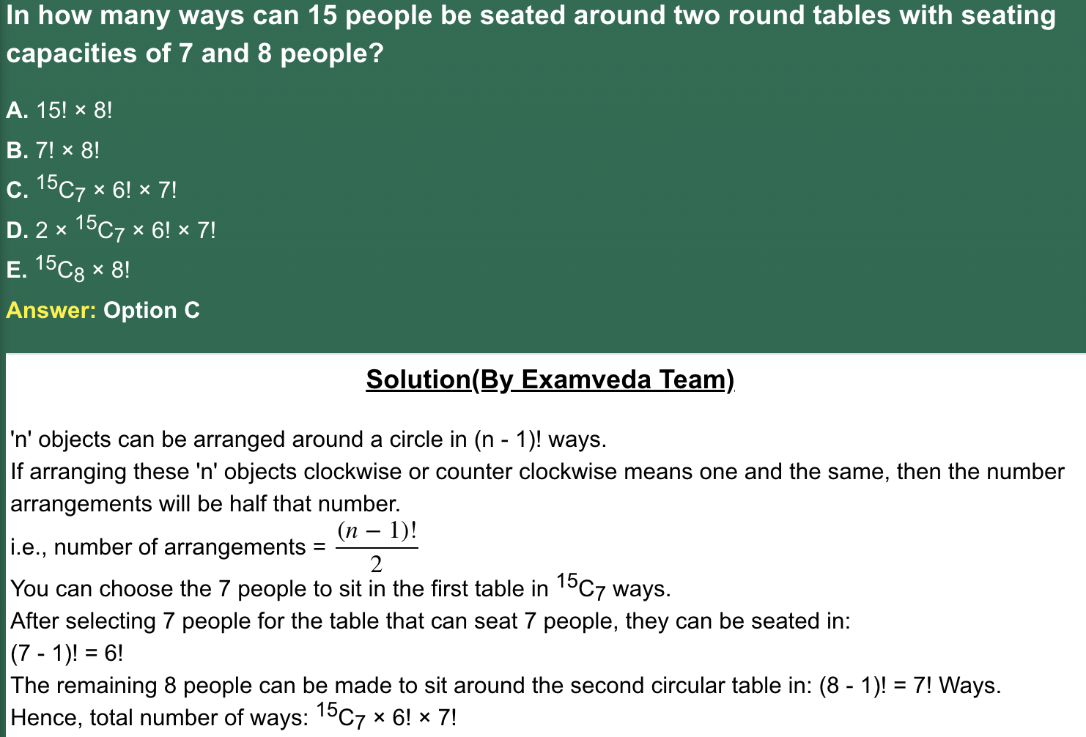
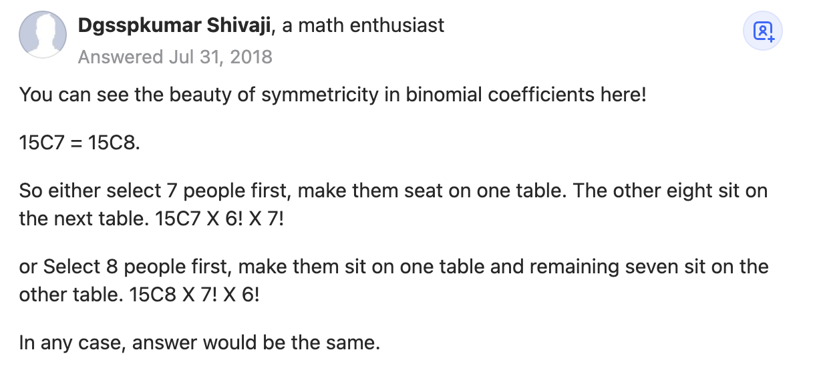

Slide 12
Question 5
In how many ways can a group of 25 people be arranged around two circular tables consisting of 12 and 13 chairs?
A)
25! x 11!/13!
B)
25
C)
25! × 12! × 12! × 13!
D)
1024
Notes:
Answer: A
The ways of selecting 12 people from 25 people is 25C₁₂. The rest 13 will be selected in one way. The ways of arranging n people in a circle is (n - 1)! Number of arrangements = 25C₁₂ × 11! × 12! = 25! x 11!/13!

Slide 13
Question 6
In a playground 3 sisters and 8 other girls are playing together. In a particular game, how many ways can all the girls be seated in a circular order so that the three sisters are not seated together?
A)
457993
B)
3386880
C)
6544873
D)
56549
Notes:
Answer: B
There are 3 sisters and 8 other girls in total 11 girls. The number of ways to arrange these 11 girls in a circular manner = (11– 1)! = 10!. These three sisters can now rearrange themselves in 3! ways.
By the multiplication theorem, the number of ways so that 3 sisters always come together in the arrangement = 8! × 3!.
Hence, the required number of ways in which the arrangement can take place if none of the 3 sisters is seated together: 10! – (8! × 3!) = 3628800 – (40320 * 6) = 3628800 – 241920 = 3386880.

Slide 14
Question 7
There are 16 people comprising two sisters. Find the number of ways in which we can arrange them around a circle so that there is exactly one person between the two sisters.
A)
14!
B)
16!
C)
16!*4!
D)
14!*2!
Notes:
Answer: D
First, arrange the two sisters around a circle in such a way that there will be one seat vacant between them. [This can be done in 2! ways since the arrangement is circular.] Then, the other 14 people can be arranged on 14 seats in 14! ways.So, total number of ways = 14! x 2! ways

Slide 15
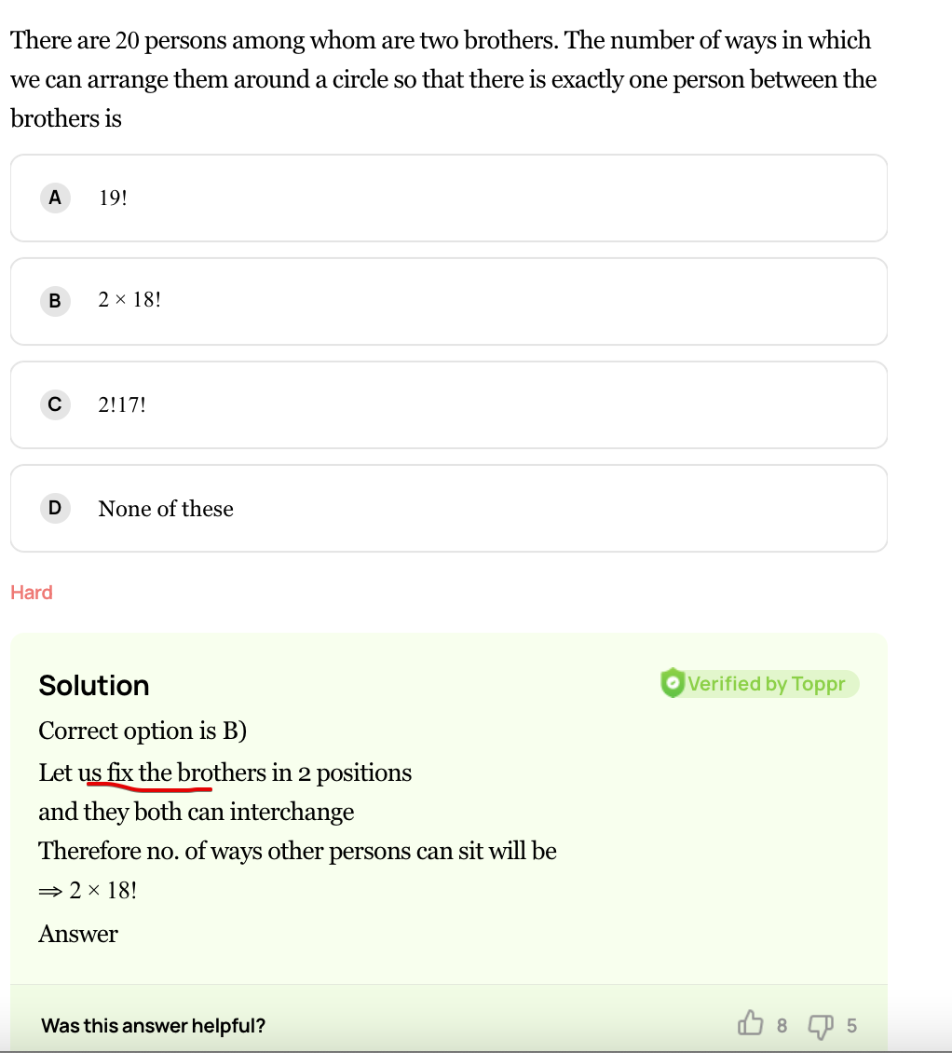

Slide 16
Question 8
Find the number of ways in which 6 people E, F, G, H, A, C can be seated at a round table, such that E and F must always sit together.
A)
32
B)
290
C)
124
D)
48
Notes:
Answer: D
E and F can sit together in all arrangements in 2! Ways. Now, the arrangement of the 5 people in a circle can be done in (5 – 1)! or 24 ways. Therefore, the total number of ways will be 24 x 2 = 48.

Slide 17
Question 9
The number of ways in which 6 men and 5 women can dine at a round table if each woman is seated in between two men is ________.
A)
6! × 5!
B)
30
C)
5! × 4!
D)
7! × 5!
Notes:
Answer: A
Image: View->Notes page
No. of ways in which 6 men can be arranged at a round table = (6 - 1)!
Now women can be arranged in 6! ways. Total Number of ways = 6! × 5!

Slide 18
Question 10
In how many ways 7 men and 7 women can be seated around a round table such that no two women can sit together?
A)
(7!)²
B)
7!×6!
C)
(6!)²
D)
7!
Notes:
Answer: B
Fix up 1 man and the remaining 6 men can be seated in 6! ways. Now no two women are to sit together and as such the 7 women are to be arranged in seven empty seats between two consecutive men and number of arrangement will be 7!. Hence by fundamental theorem the total number of ways = 7! × 6!.

Slide 19
Question 11
The number of ways in which 5 male and 2 female members of a committee can be seated around a round table so that the two female are not seated together is _______.
A)
480
B)
600
C)
720
D)
840
Notes:
Answer: A
Fix up a male and the remaining 4 male can be seated in 4! ways. Now no two female are to sit together and as such the 2 female are to be arranged in five empty seats between two consecutive male and number of arrangement will be 5P2.
Hence by fundamental theorem the total number of ways is = 4!×5P2
= 24 × 20 = 480 ways.

Slide 20
Question 12
How many different garlands can be made using 12 flowers of different colours?
A)
10 ! ×2
B)
11!/ 2
C)
9! ×2
D)
None of these
Notes:
Answer: B
The garland can be made in anti-clockwise and clockwise direction. As clockwise and anti-clockwise direction is considered to be the same, we take,
½ (n -1)!Here n = 12
Step 2:
½ (12 – 1)! =
11!/ 2
Therefore, In 11!/ 2 ways can be found to make garlands from 12 different coloured flowers.

Slide 21
Question 13
20 persons are invited for a party. In how many different ways can they and the host be seated at a circular table, if the two particular persons are to be seated on either side of the host?
A)
20 !
B)
2 . 18 !
C)
18 !
D)
None of these
Notes:
Answer: B
There are 20 + 1 = 21 persons in all. The two particular persons and the host be taken as one unit so that these remain 21 - 3 + 1 = 19 persons to be arranged in 18 ! ways. But the two person on either side of the host can themselves be arranged in 2! ways. Hence there are 2 ! 18 ! ways or 2.18!
ways.

Slide 22
Question 14
In how many ways can 15 members of a council sit along a circular table, when the Secretary is to sit on one side of the Chairman and the Deputy Secretary on the other side?
A)
2×12!
B)
24
C)
2×15!
D)
None of these
Notes:
Answer: A
Since total members are 15, but one is to left, because of circular condition, therefore remaining members are 14 but three special member constitute a member. Therefore required number of arrangements are12 ! ×2
, because, chairman remains between the two specified persons and the person can sit in two ways.

Slide 23
Question 15
If eleven members of a committee sit at a round table so that the President and Secretary always sit together, then the number of arrangements is
A)
10 ! ×2
B)
10!
C)
9! ×2
D)
None of these
Notes:
Answer: C
Required number of ways9 ! ×2. {By fundamental property of circular permutation}.

Slide 24

THANK YOU

